Slide 1
Evaluating the Financial Impact of Loans and Investments
Chapter 6
Notes:
Use the quote as a jumping off point for discussion, if desired.

Slide 2
Chapter Introduction
Fundamental financial calculations used to evaluate different financing options
An amortization table—a listing by period of the cash inflows and outflows
Excel tools for calculating depreciation (a technique used to allocate costs of an asset over its useful life)

Slide 3
Chapter Introduction (continued)
Ramifications of cash flows; tools for analyzing the financial viability of a project
To go to Level 1, click here
To go to Level 2, click here
To go to Level 3, click here

Slide 4
Functions Covered in This Chapter
CUMIPMT
CUMPRINC
DDB
FV
IPMT
IRR
NPER
NPV
PMT
PPMT
PV
RATE
SLN

Slide 5
Level 1 Objectives: Calculating Values for Simple Financial Transactions
Understand how simple interest and compound interest are calculated
Determine the value of a loan payment
Analyze positive and negative cash flows
Determine the future value and the present value of a financial transaction
Determine the interest rate and the number of periods of a financial transaction

Slide 6
Understanding How Interest Is Calculated
Factors that can affect interest:
How long do you want to borrow the money?
What level of risk is the lender assuming in lending the money?
What are the current monetary policies of governments that affect interest rates?
Ways interest is accounted for:
Simple interest
Compound interest
Level 1 home

Slide 7
Understanding How Interest Is Calculated (continued)
Simple interest
Paid solely on the amount of the original principal value
Simple interest = Principal * Interest rate per time period * Number of time periods
Level 1 home

Slide 8
Understanding How Interest Is Calculated (continued)
Compound interest
Adding interest earned each period to the principal for purposes of computing interest for the next period
Has greater total value than simple interest
Used by most financial institutions
Annual percentage yield (APY)
An equivalent yearly simple interest rate, taking compounding into account
Annual percentage rate (APR)
Reflects interest being paid on the actual amount borrowed
Level 1 home

Slide 9
Reviewing Alternative Financing Options
Excel’s financial functions perform calculations to help determine the most feasible financing option
PMT
RATE
NPER
PV
FV
Level 1 home

Slide 10
Using the PMT Function to Determine a Loan Payment
PMT function
Finds the value of the payment per period, assuming there are constant payments and a constant interest rate for the duration of the loan
=PMT(rate,nper,pv,[fv],[type])
Level 1 home

Slide 11
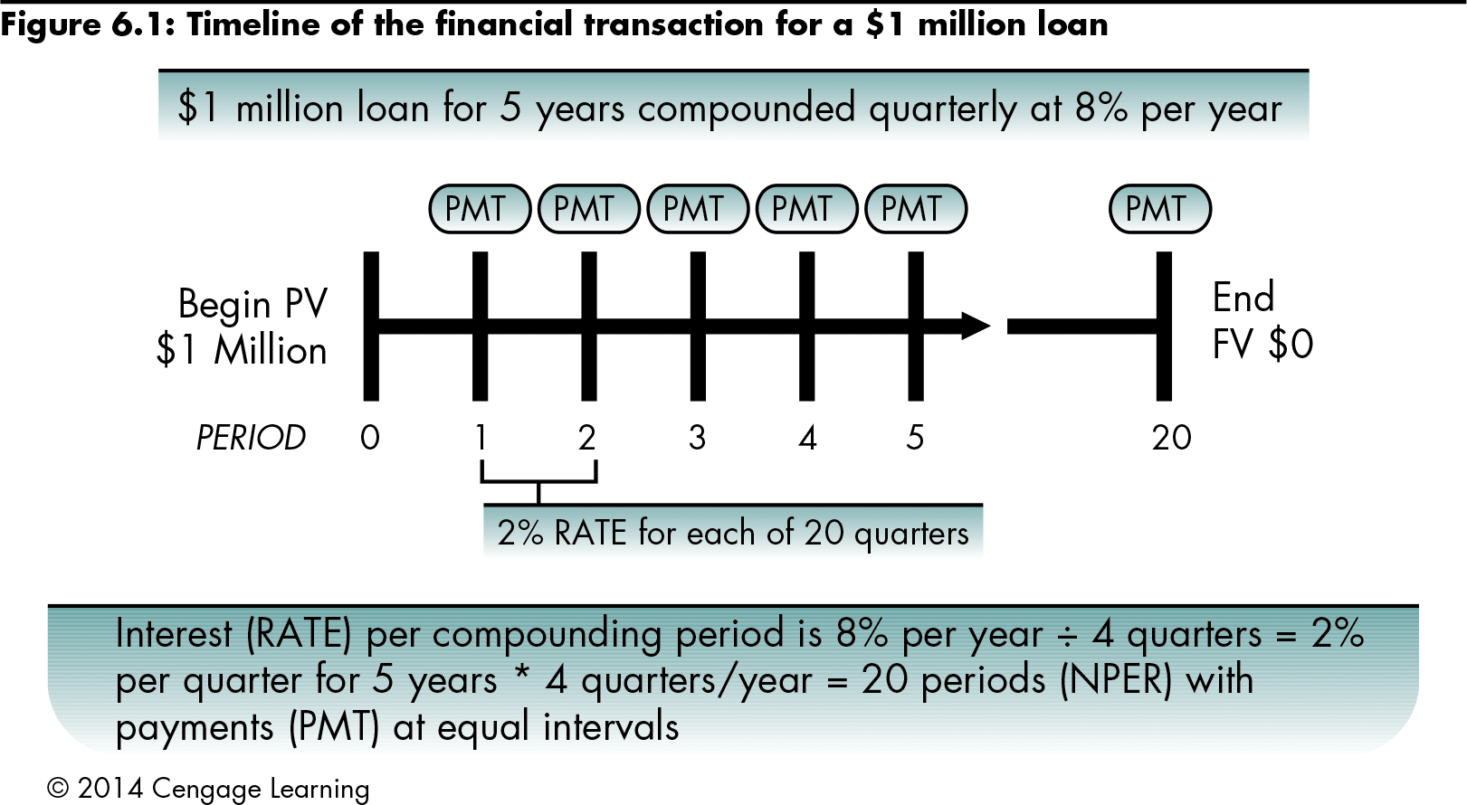
Using the PMT Function to Determine a Loan Payment (continued)
Level 1 home

Slide 12
Using the PMT Function to Determine a Loan Payment (continued)
Arguments of the PMT Function
rate | Interest rate per compounding period
nper | Number of compounding periods
pv | Present value
fv | Future value (compounded amount)
type | Designates when payments are made Type 0: end of period Type 1: beginning of period
Level 1 home

Slide 13
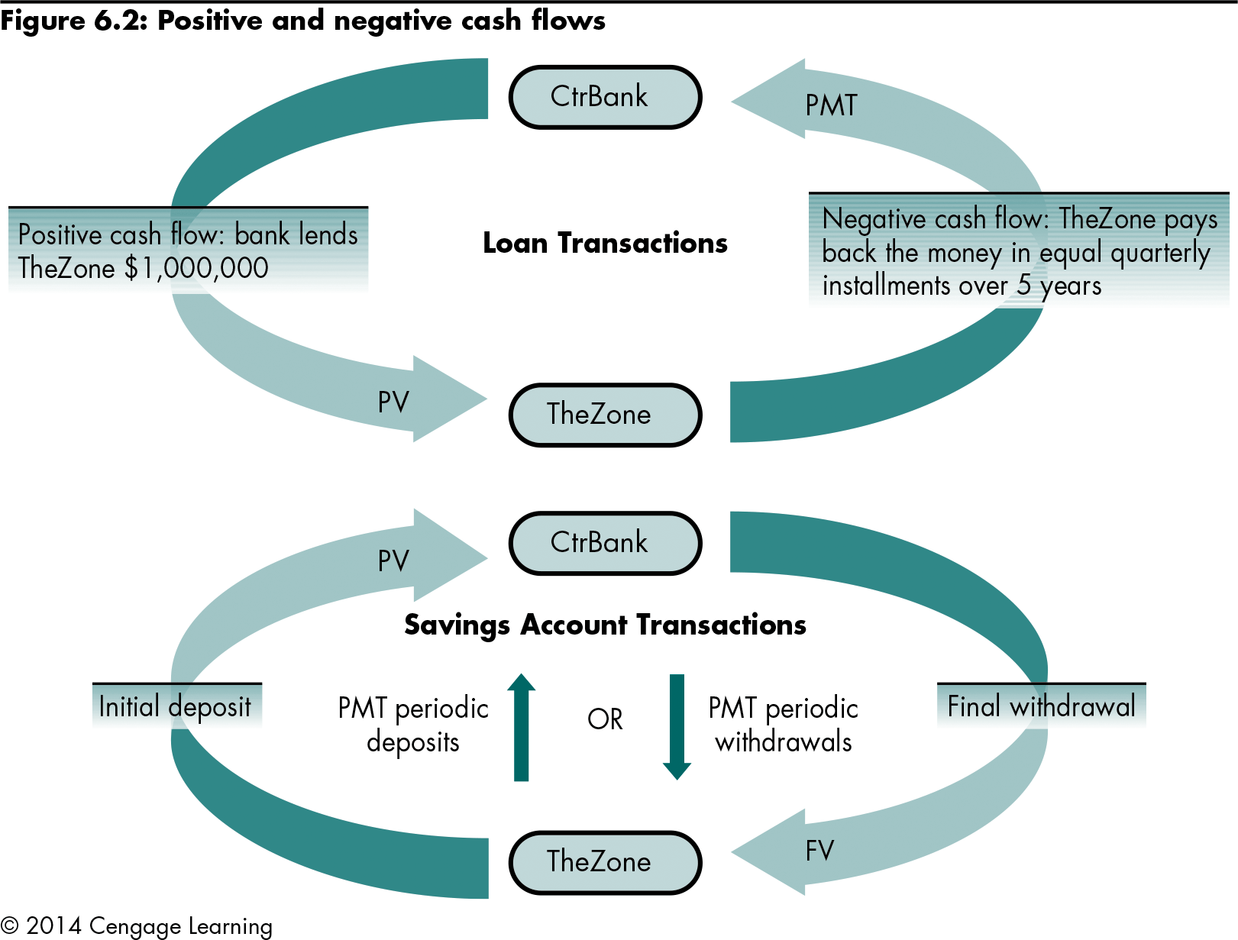
Using the PMT Function to Determine a Loan Payment (continued)
Level 1 home

Slide 14
Using the PMT Function to Determine a Loan Payment (continued)
Financial functions apply the interest rate per period and the payment per period to the principal value over a specified number of periods
Level 1 home

Slide 15
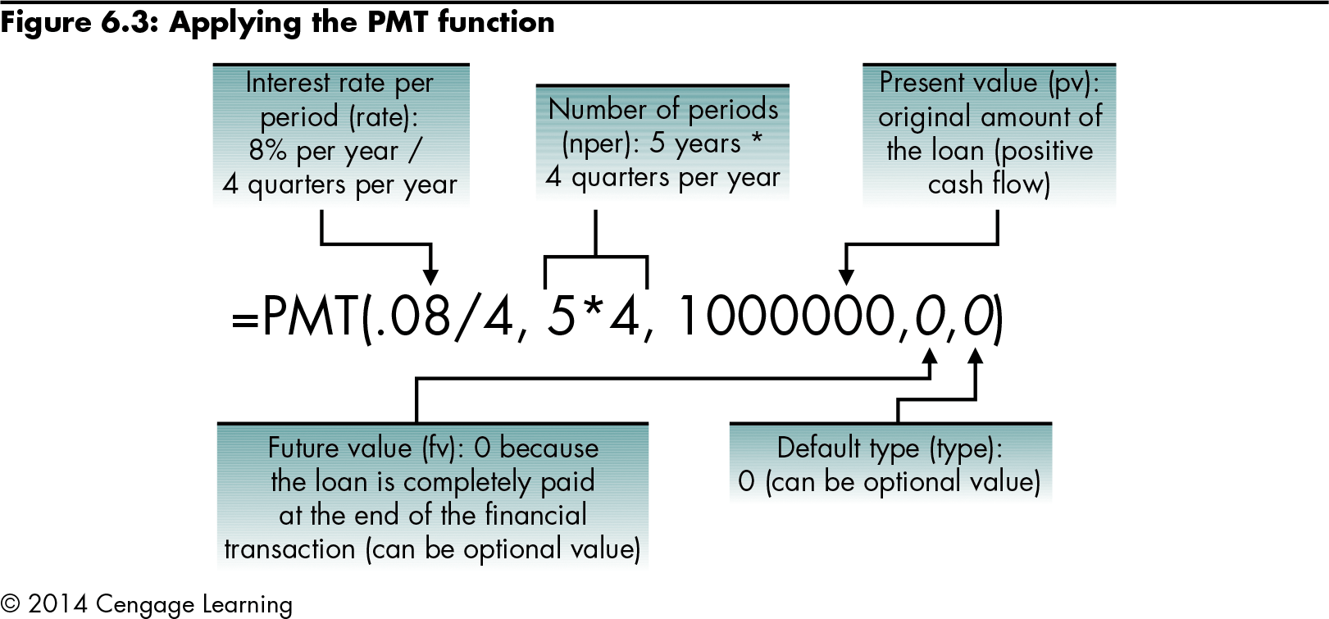
Using the PMT Function to Determine a Loan Payment (continued)
Level 1 home

Slide 16
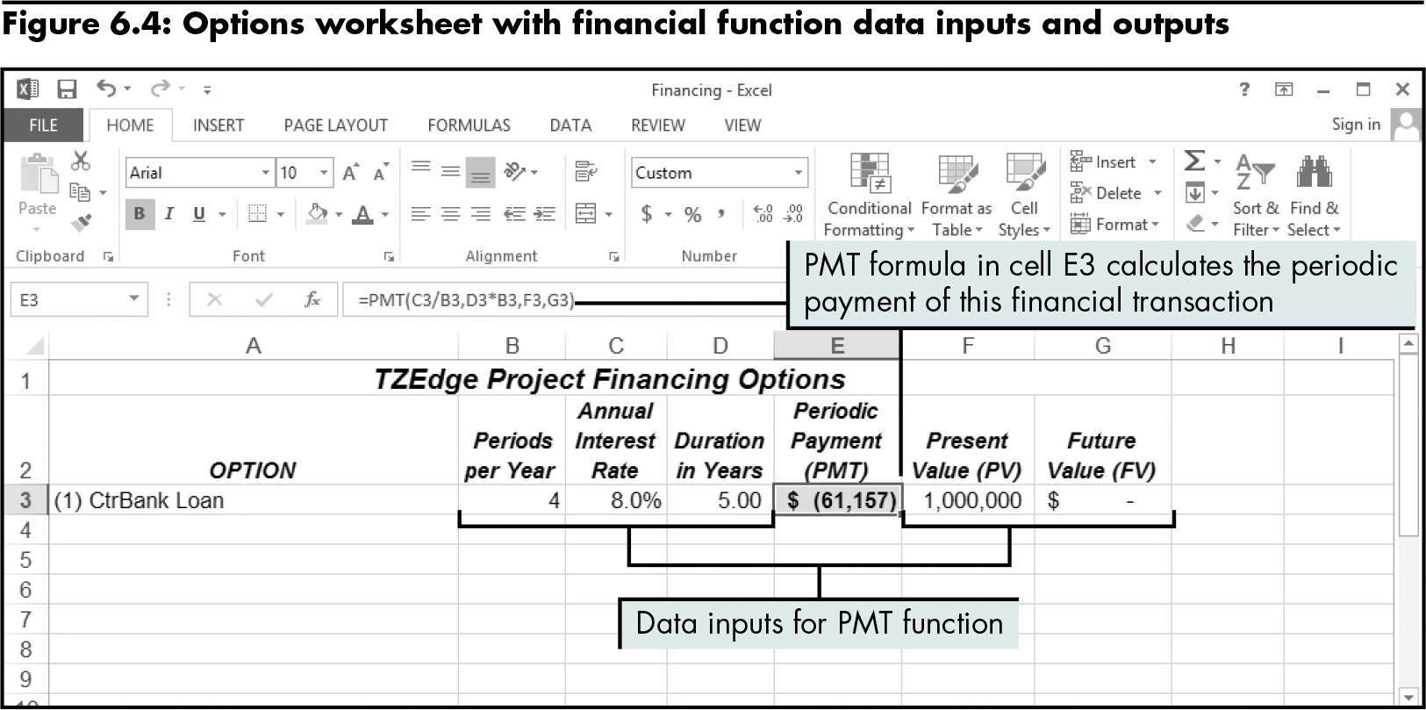
Using the PMT Function to Determine a Loan Payment (continued)
Level 1 home

Slide 17
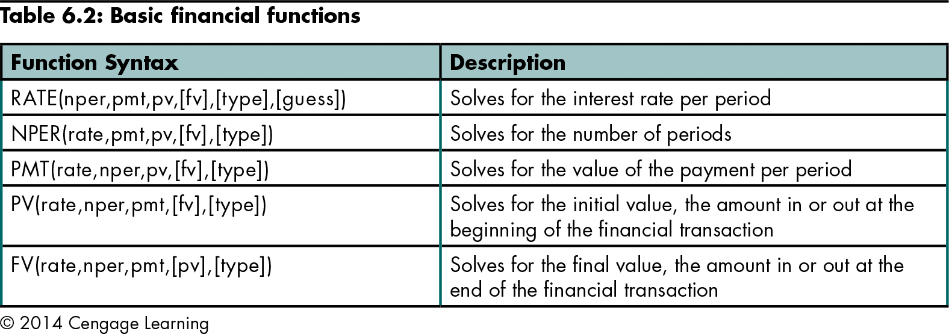
Using the RATE, NPER, PV, and FV Functions
Level 1 home

Slide 18
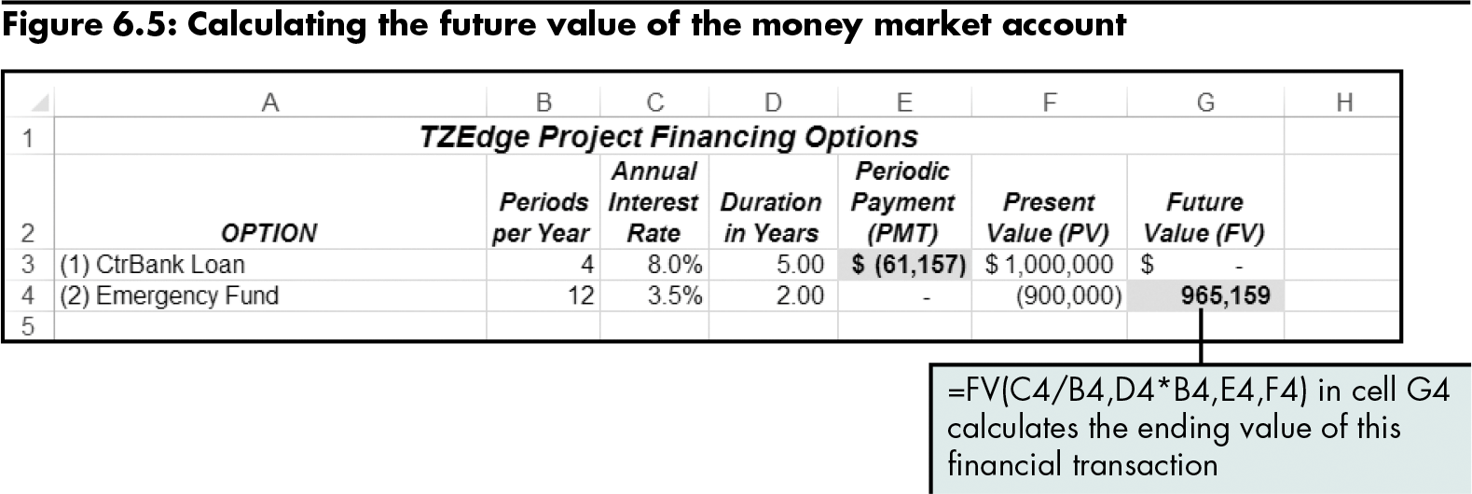
Using the RATE, NPER, PV, and FV Functions (continued)
Level 1 home

Slide 19
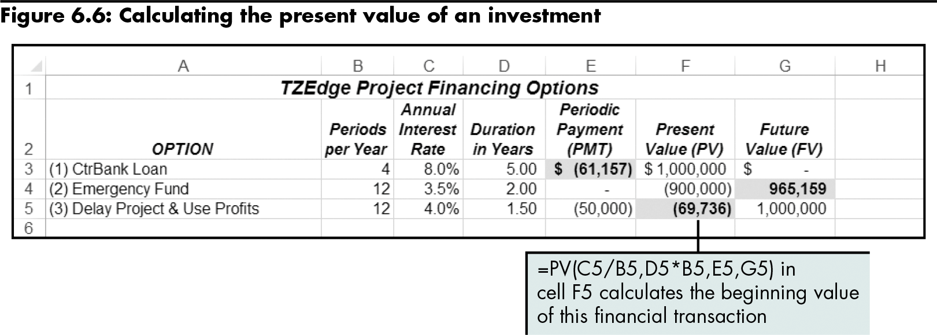
Using the RATE, NPER, PV, and FV Functions (continued)
Level 1 home

Slide 20
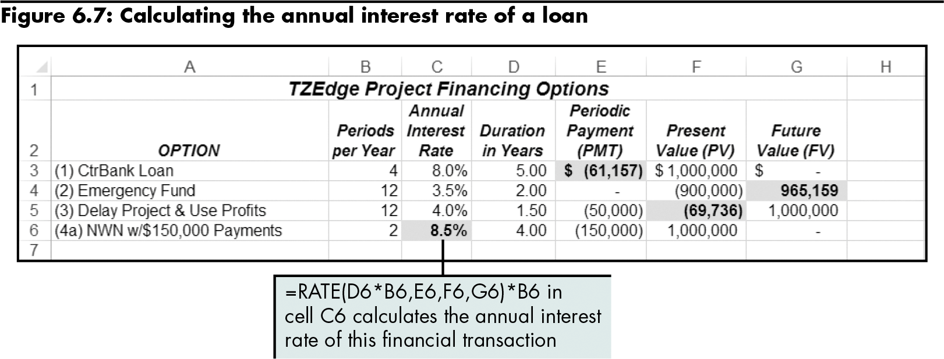
Using the RATE, NPER, PV, and FV Functions (continued)
Level 1 home

Slide 21
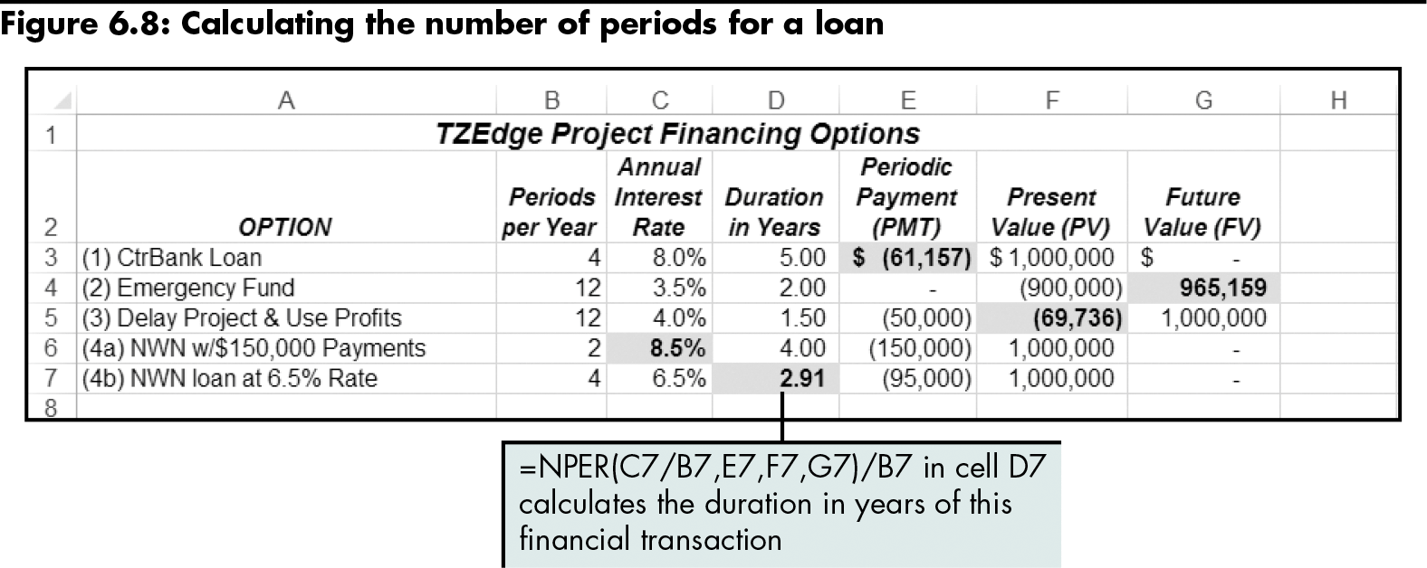
Using the RATE, NPER, PV, and FV Functions (continued)
Level 1 home

Slide 22
Using the RATE, NPER, PV, and FV Functions (continued)
Writing Formulas for Other Loan Options
Down payment | Adjust the present value (pv) to reflect the exact value of the loan
Balloon payment | Specify the negative future value (fv)
Mortgage fees | Adjust the pv of the loan by subtracting the fees from the loan amount Recalculate the interest rate using the same payments and loan periods, with the new pv amount
Level 1 home

Slide 23
Level 1 Summary
Using basic Excel functions to calculate the elements of a loan (PMT, RATE, NPER, PV, FV)
Understanding how these functions affect positive and negative cash flows of a financial institution

Slide 24
Level 2 Objectives: Creating a Projected Cash Flow Estimate and Amortization Schedule
Set up an amortization table to evaluate a loan
Create a sequence of numbers automatically
Calculate principal and interest payments
Calculate cumulative principal and interest payments
Set up named ranges for a list
Calculate depreciation and taxes

Slide 25
Designing a Worksheet to Estimate Cash Flow
Cash flow
The amount of money coming into or out of a company each year
A combination of revenues and expenses with the effects of required capital investment and financing
Level 2 home

Slide 26
Designing a Worksheet to Estimate Cash Flow (continued)
Depreciation
The process by which a company spreads the expense of an asset over its useful life
Level 2 home

Slide 27
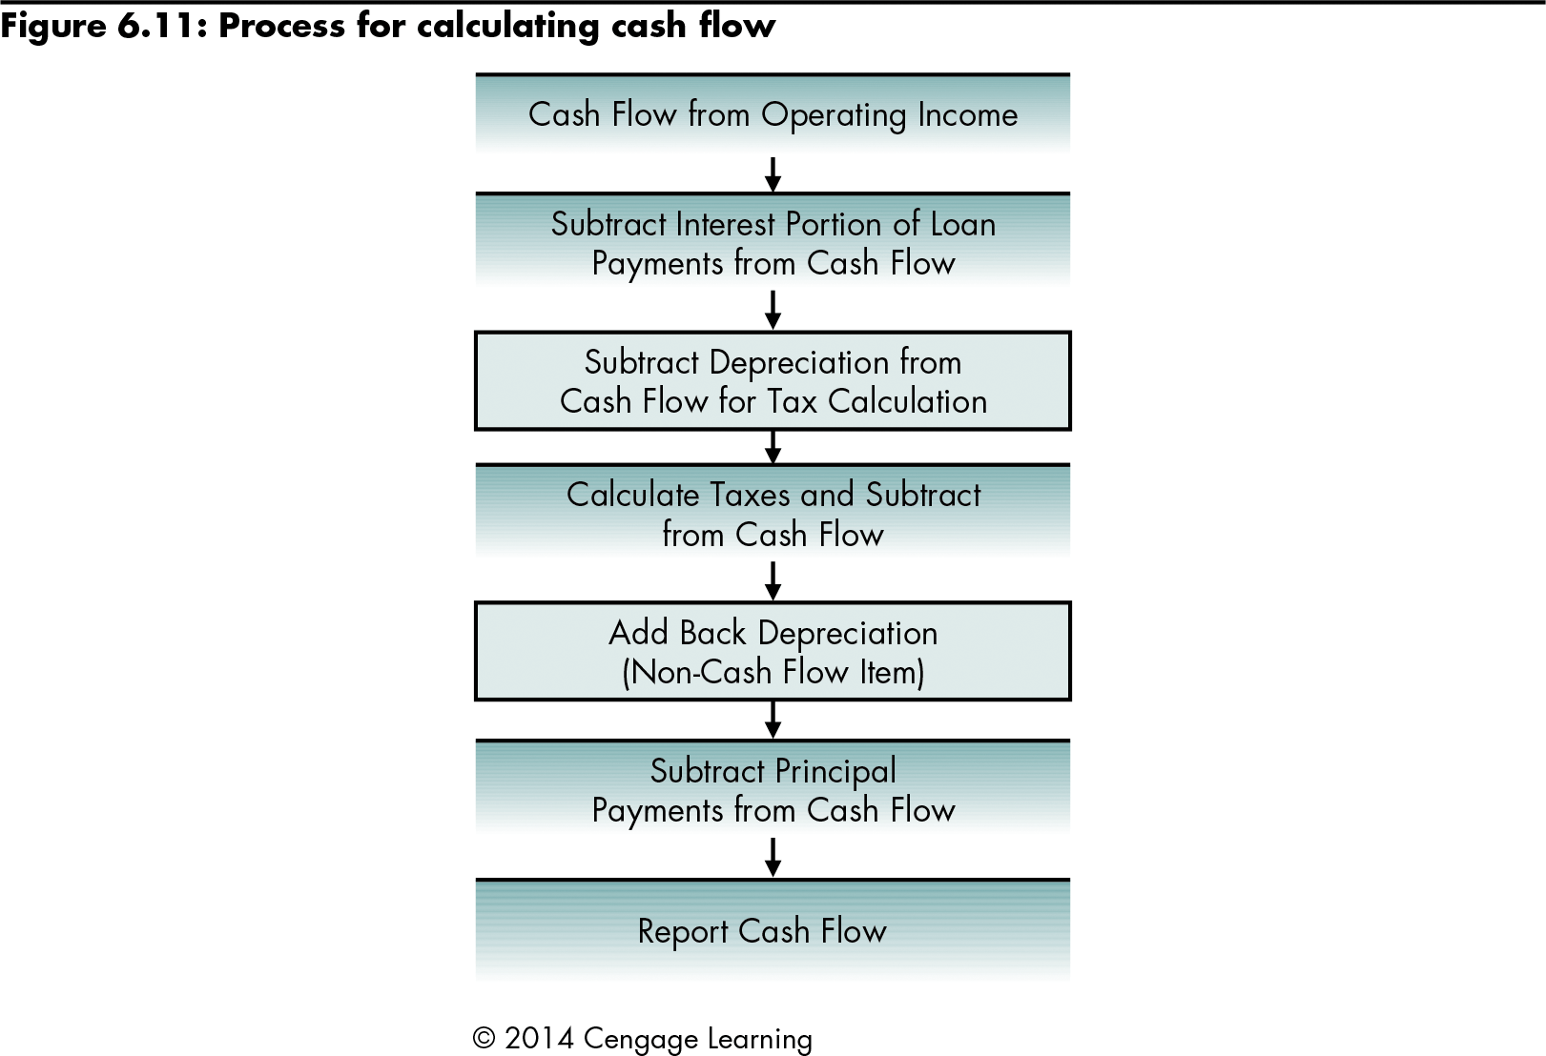
Designing a Worksheet to Estimate Cash Flow (continued)
Level 2 home

Slide 28
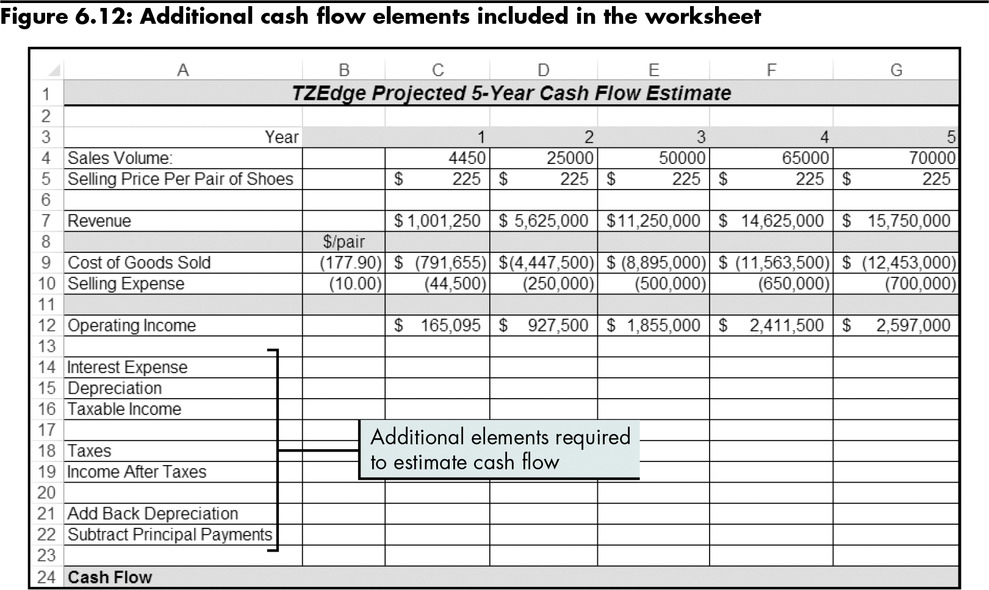
Designing a Worksheet to Estimate Cash Flow (continued)
Level 2 home

Slide 29
Setting Up an Amortization Schedule
Amortization schedule
A standard method of detailing a loan transaction
For each specific loan period, it lists the remaining principal and the value of the payment apportioned to interest expense and to paying down the principal
Level 2 home

Slide 30
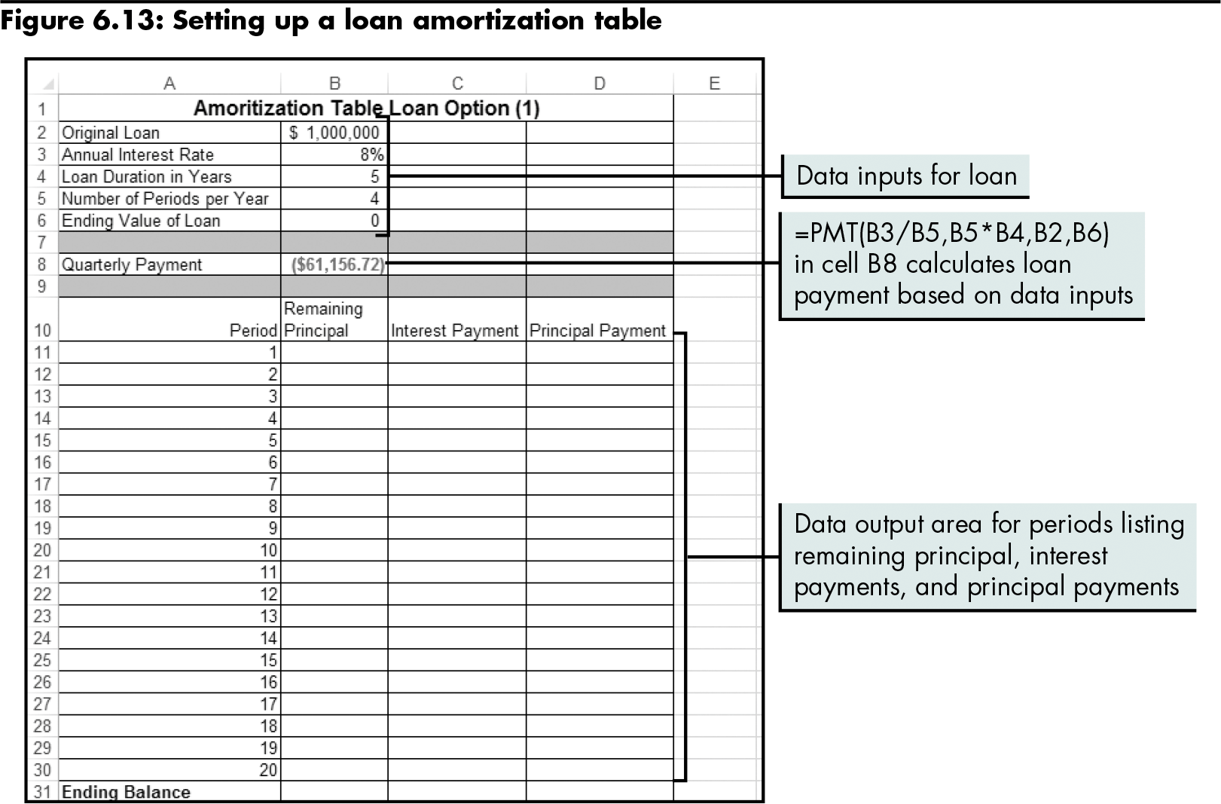
Setting Up an Amortization Schedule (continued)
Level 2 home

Slide 31
Setting Up an Amortization Schedule (continued)
IPMT function
Calculates the value of the interest payment for a specified period
=IPMT(rate,per,nper,pv,[fv],[type])
PPMT function
Calculates the value of the principal payment for a specified period
=PPMT(rate,per,nper,pv,[fv],[type])
Level 2 home

Slide 32
Setting Up an Amortization Schedule (continued)
Arguments of the PPMT and IPMT Functions
rate | Interest rate per period
per | Period for which the interest or principal amount will be calculated
nper | Total number of periods in the financial transaction
pv | Value at the beginning of the financial transaction
fv | Value at the end of the financial transaction
type | Payment type of 0 or 1 (made at the end or beginning of each period, respectively)
Level 2 home

Slide 33
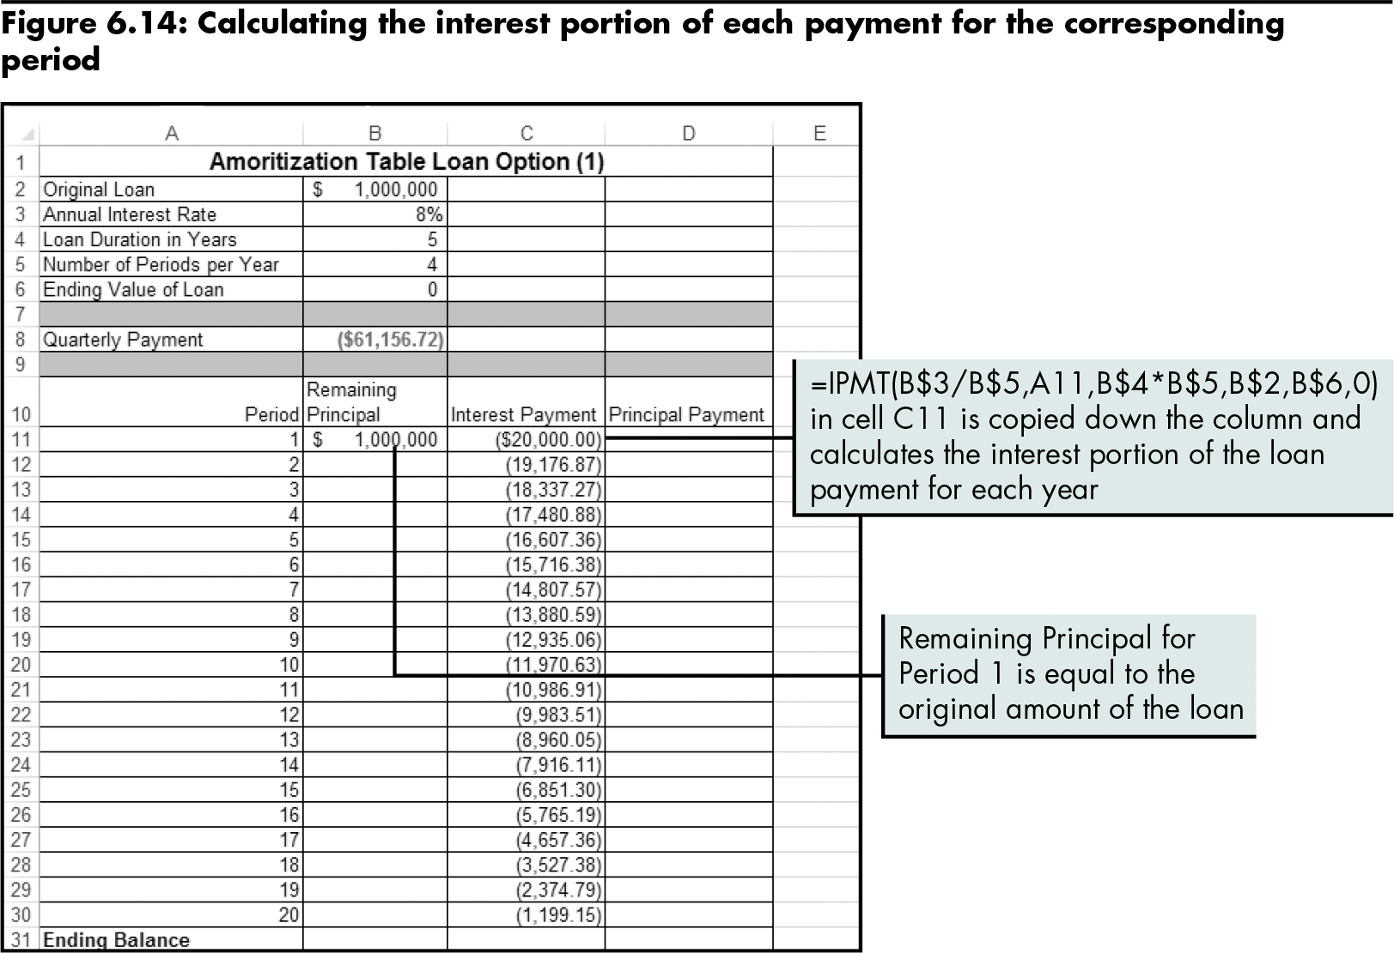
Setting Up an Amortization Schedule (continued)
Level 2 home

Slide 34
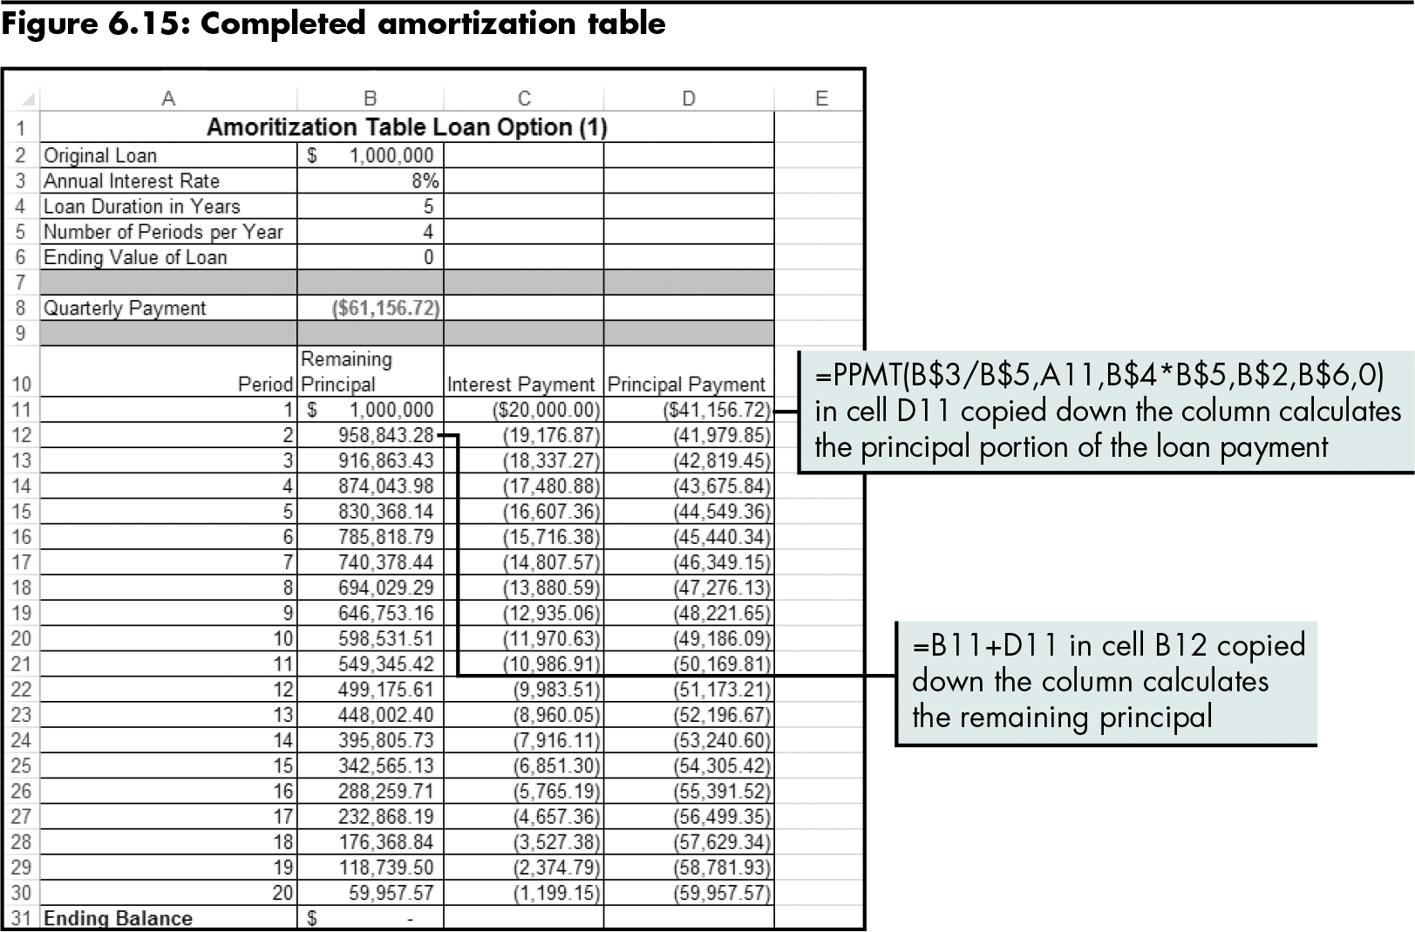
Setting Up an Amortization Schedule (continued)
Level 2 home

Slide 35
Setting Up an Amortization Schedule (continued)
CUMIPMT function
Automatically calculates the interest values between a start period and an end period
=CUMIPMT(rate,nper,pv,start_period, end_period,type)
CUMPRINC function
Automatically calculates the principal values between a start period and an end period
=CUMPRINC(rate,nper,pv,start_period, end_period,type)
Level 2 home

Slide 36
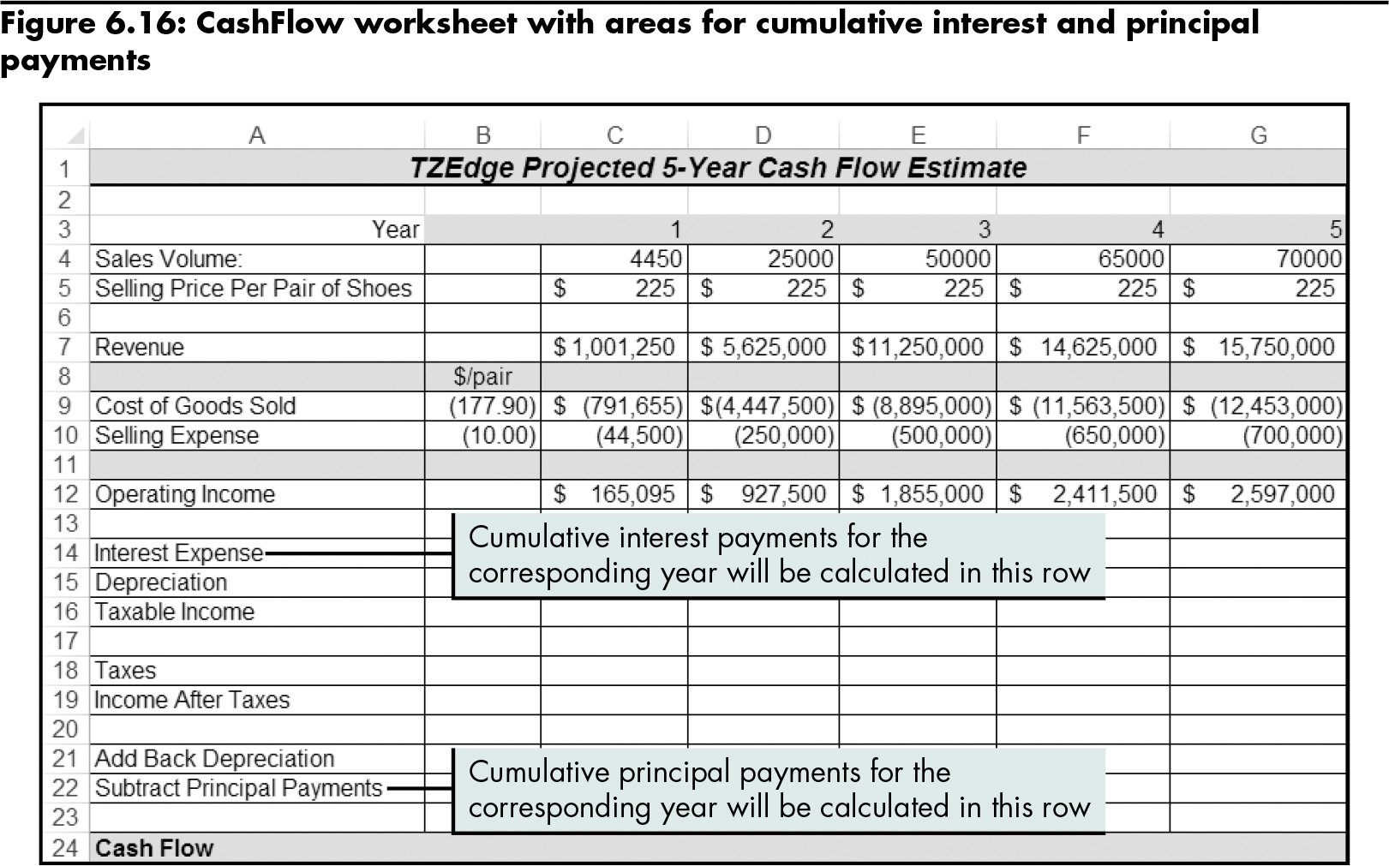
Setting Up an Amortization Schedule (continued)
Level 2 home

Slide 37
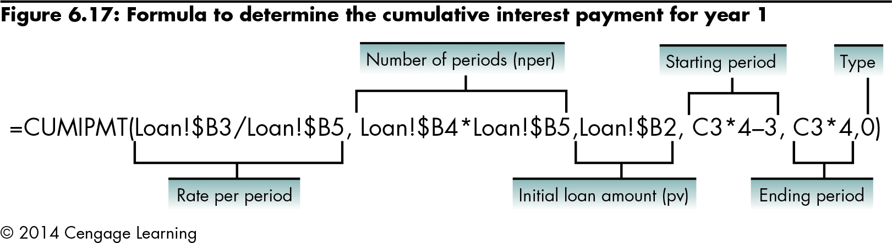
Setting Up an Amortization Schedule (continued)
Level 2 home

Slide 38
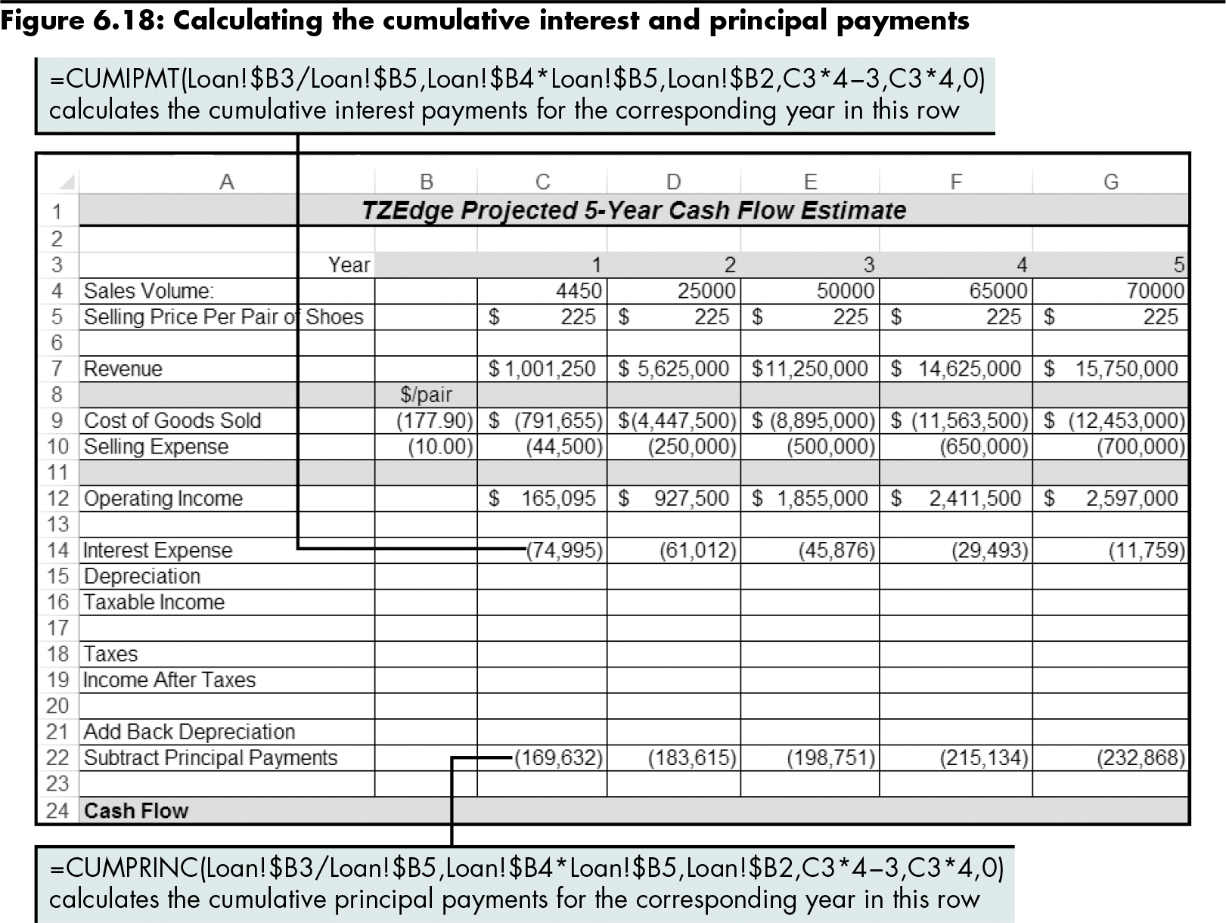
Setting Up an Amortization Schedule (continued)
Level 2 home

Slide 39
Calculating Depreciation Using the SLN Function
Straight line depreciation method
Approximation of the actual depreciation allowed by the tax code
Allocates the value of an asset evenly throughout the life of the asset
=SLN(cost,salvage,life)
Cost: The initial cost of the asset
Salvage: The value at the end of depreciation
Life: The number of periods over which the asset is depreciated
Level 2 home

Slide 40
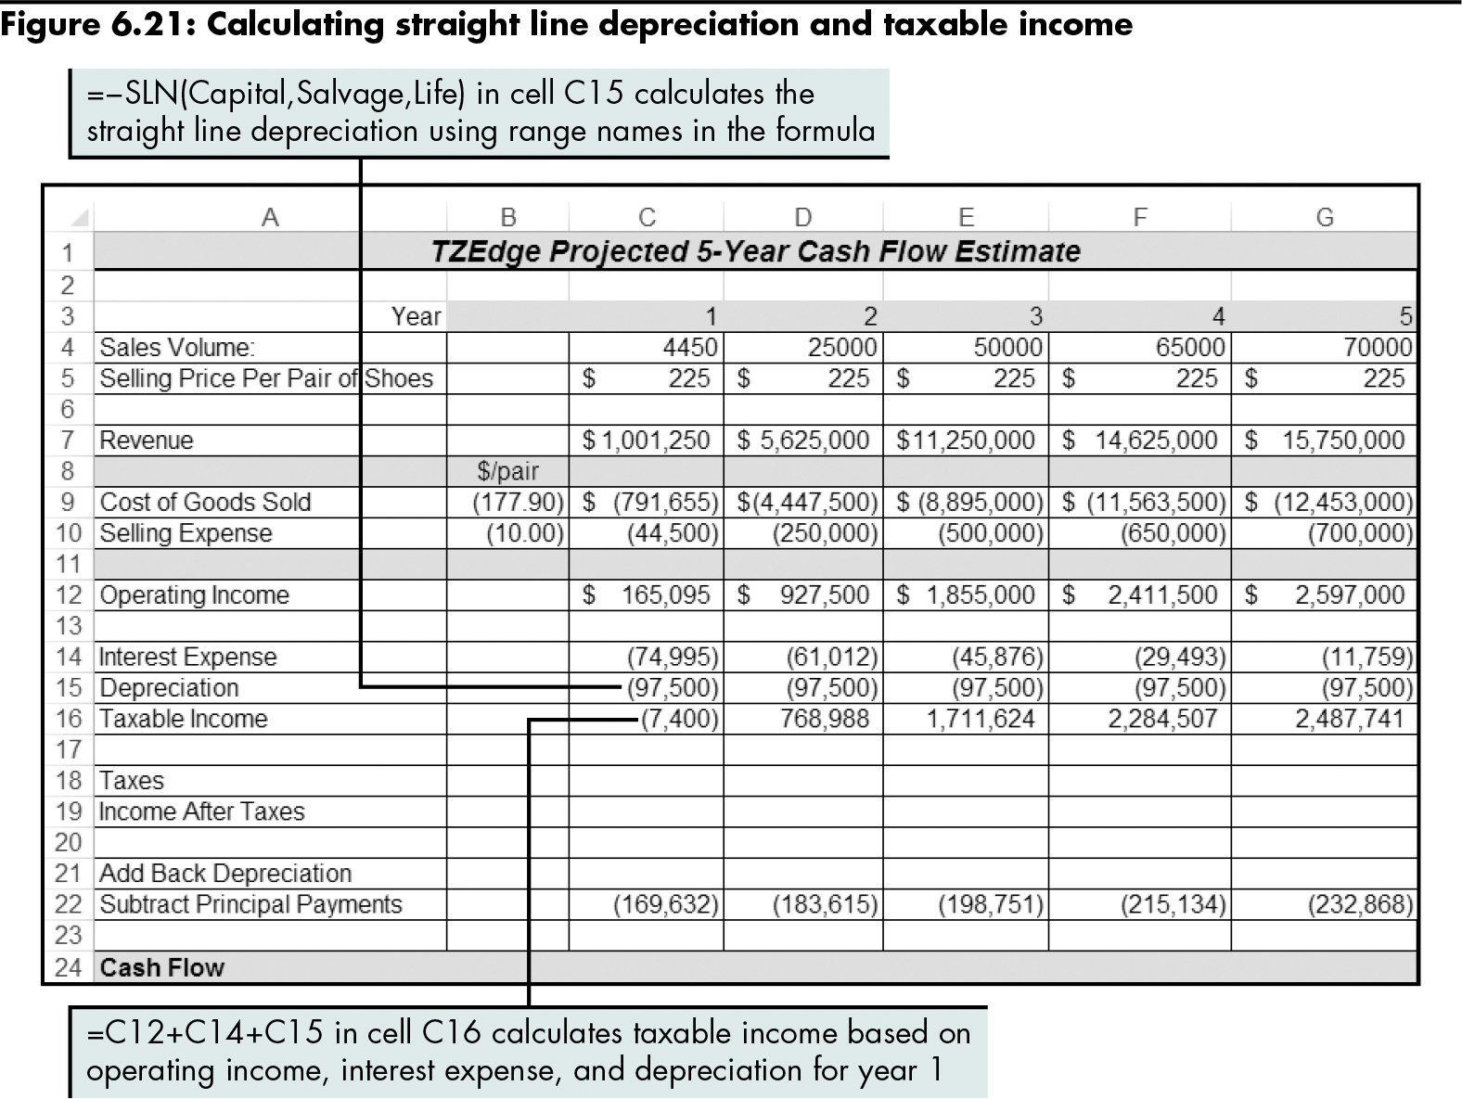
Calculating Depreciation Using the SLN Function (continued)
Level 2 home

Slide 41
Calculating Depreciation Using the SLN Function (continued)
Alternative Depreciation Options Provided in Excel
Function | Definition | Syntax
Double-declining balance | Computes depreciation at an accelerated rate | =DDB(cost,salvage,life, period,[factor])
Sum of the years digits | Depreciation is apportioned based on the declining fractional amount of the asset’s life | =SYD(cost,salvage,life, per)
Fixed-declining balance | Returns the depreciation of an asset for a specified period using the fixed-declining balance method | =DB(cost,salvage,life, period,[month])
Variable-declining balance | Returns the depreciation of an asset for a specified period using the double-declining balance method | =VDB(cost,salvage,life, start_period,end_period, factor,no_switch)
Level 2 home

Slide 42
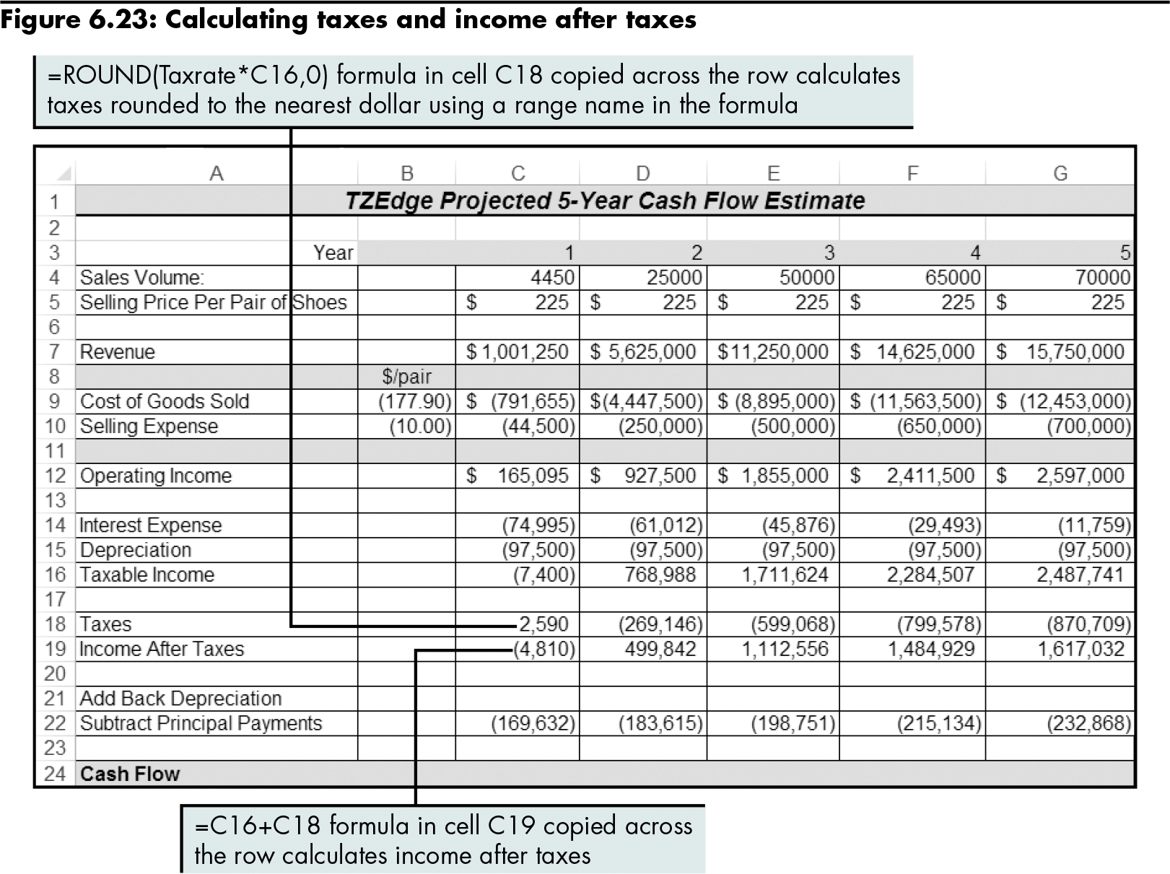
Calculating Taxes
Level 2 home

Slide 43
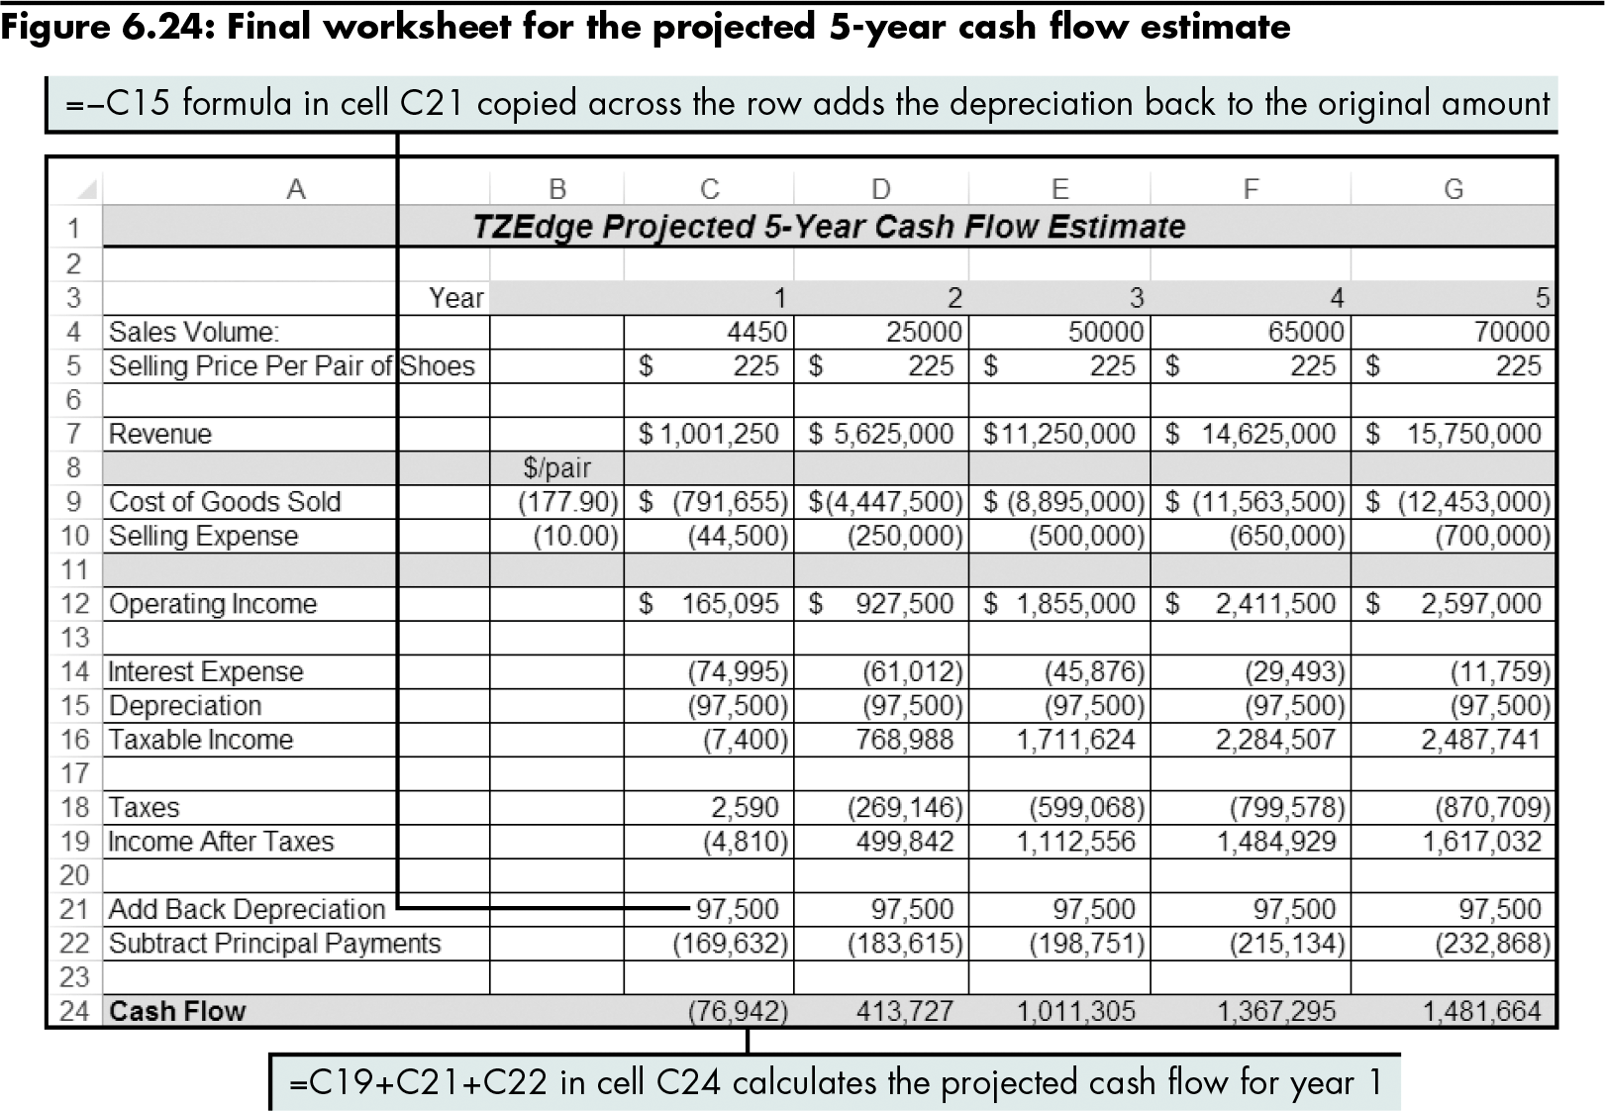
Calculating Taxes (continued)
Level 2 home

Slide 44
Level 2 Summary
Using amortization tables
Calculating principal and interest payments with PPMT and IPMT
Calculating cumulative principal and interest payments with CUMPRINC and CUMIPMT
Calculating depreciation using the straight line method
Calculating taxes

Slide 45
Level 3 Objectives: Evaluating the Financial Viability of Alternative Project Options
Set up a worksheet to analyze profitability
Calculate the net present value
Calculate the internal rate of return
Calculate the return on investment
Determine the payback period

Slide 46
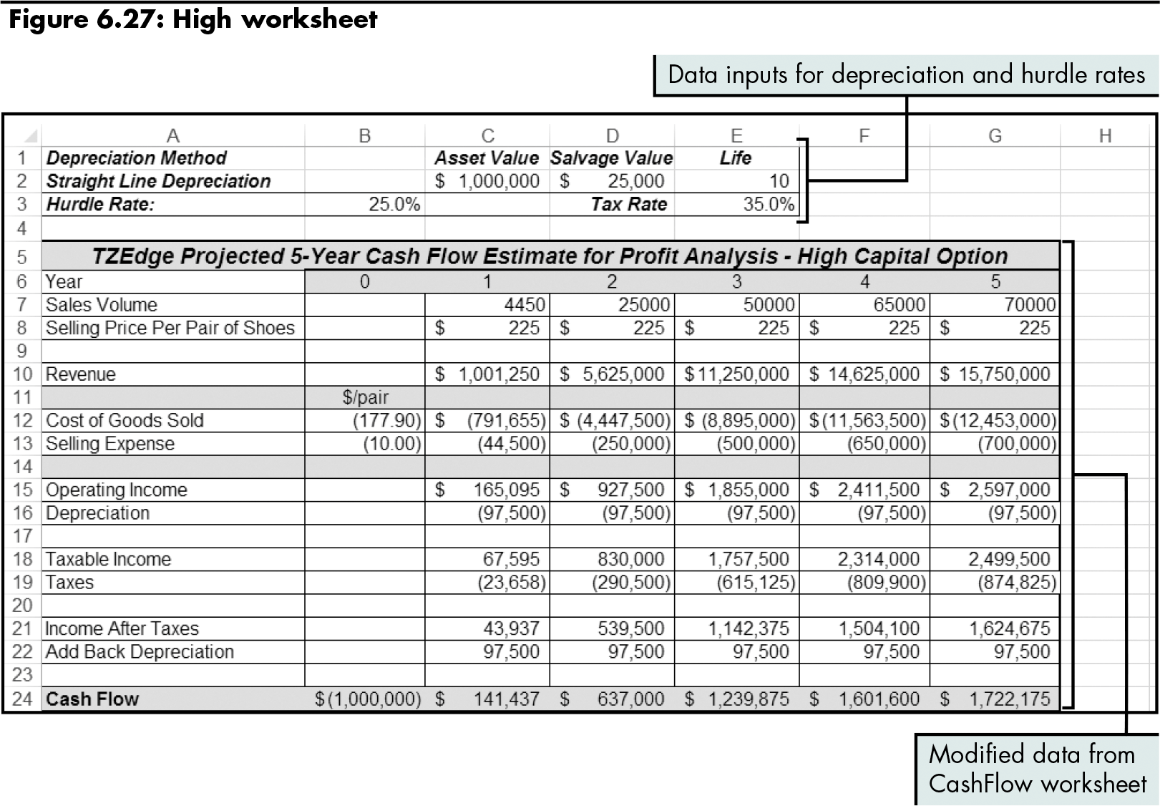
Setting Up a Worksheet to Analyze Profitability
Level 3 home

Slide 47
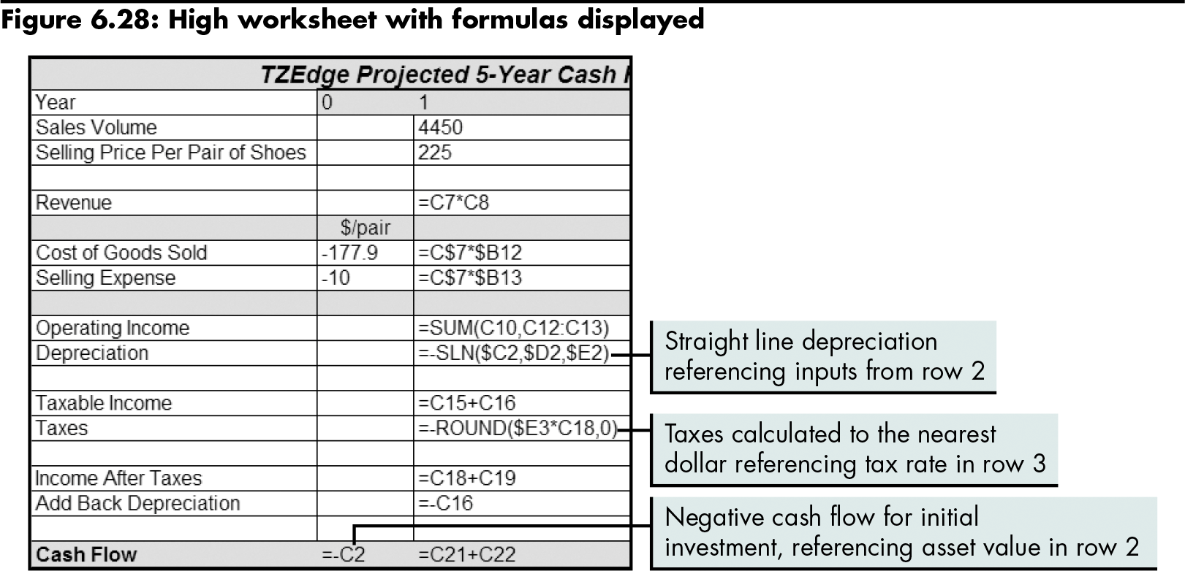
Setting Up a Worksheet to Analyze Profitability (continued)
Level 3 home

Slide 48
Calculating Net Present Value
Net present value (NPV)
Uses expected cash flows and applies a minimum rate of return (hurdle rate) to discount these cash flows into current (present) value dollars
Enables you to see the current worth of projected cash flows
=NPV(rate,value1,[value2],…)
Has several requirements
Level 3 home

Slide 49
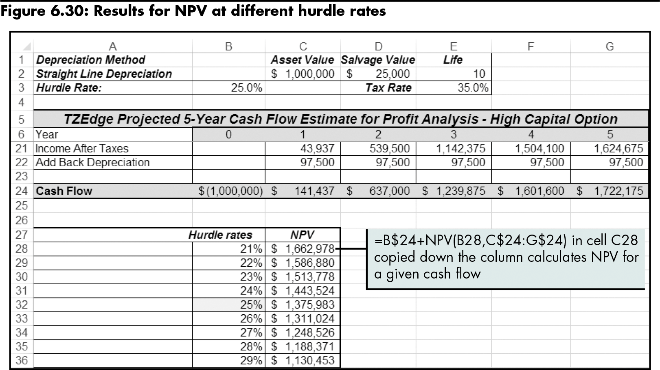
Calculating Net Present Value (continued)
Level 3 home

Slide 50
Calculating the Internal Rate of Return
Internal rate of return (IRR)
Considers the cash flows and discounts them back to the present value
Calculates the rate at which the discounted cash flows in and out are equal
=IRR(values,[guess])
Level 3 home

Slide 51
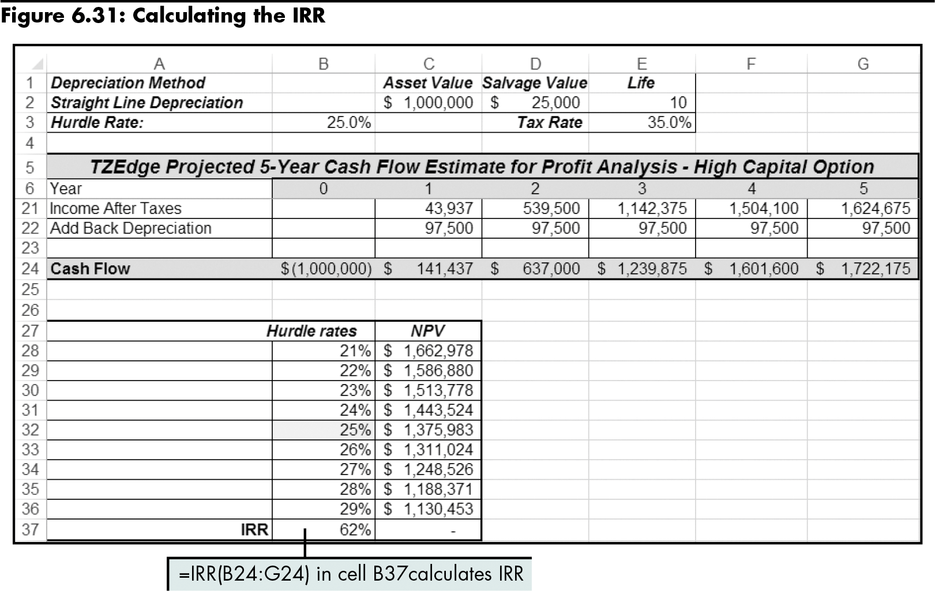
Calculating the Internal Rate of Return (continued)
Level 3 home

Slide 52
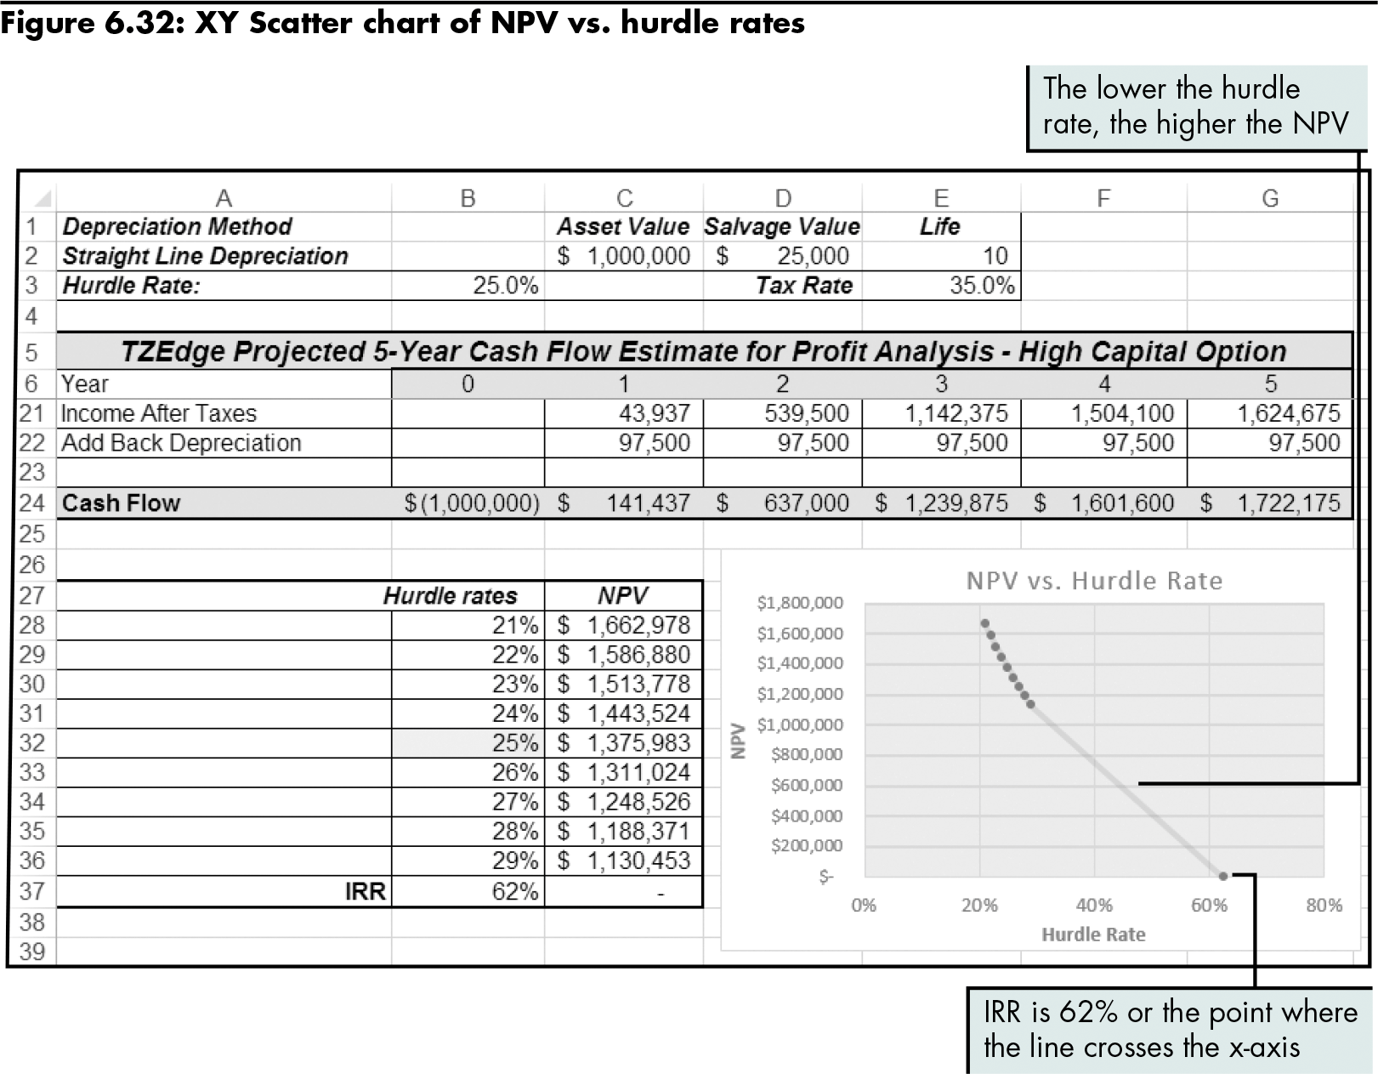
Calculating the Internal Rate of Return (continued)
Level 3 home

Slide 53
Calculating the Return on Investment
Return on investment (ROI)
The sum of the cash flows, excluding initial investment, divided by the investment value
Level 3 home

Slide 54
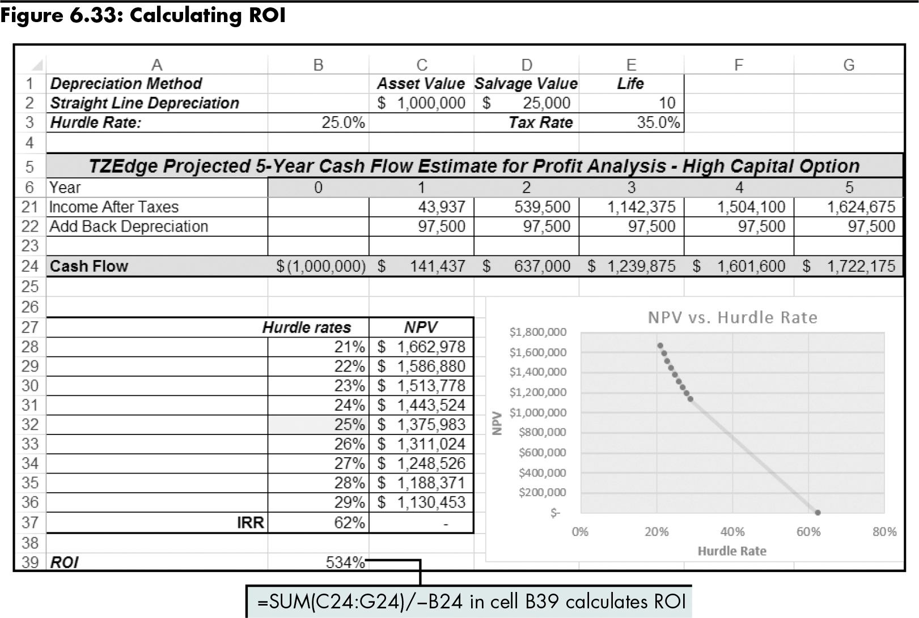
Calculating the Return on Investment (continued)
Level 3 home

Slide 55
Determining the Payback Period
Payback period
The time it will take to earn sufficient profits so the loan can be paid back
Payback year
The year in which the cumulative total cash flow is greater than or equal to $0
Level 3 home

Slide 56
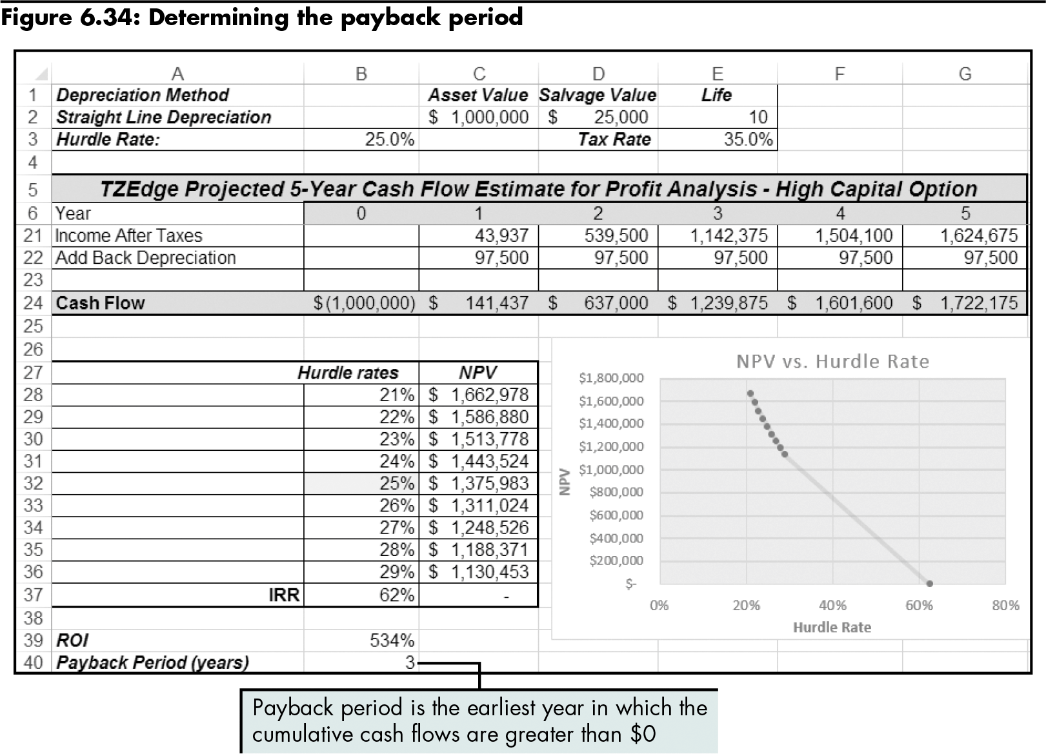
Determining the Payback Period (continued)
Level 3 home

Slide 57
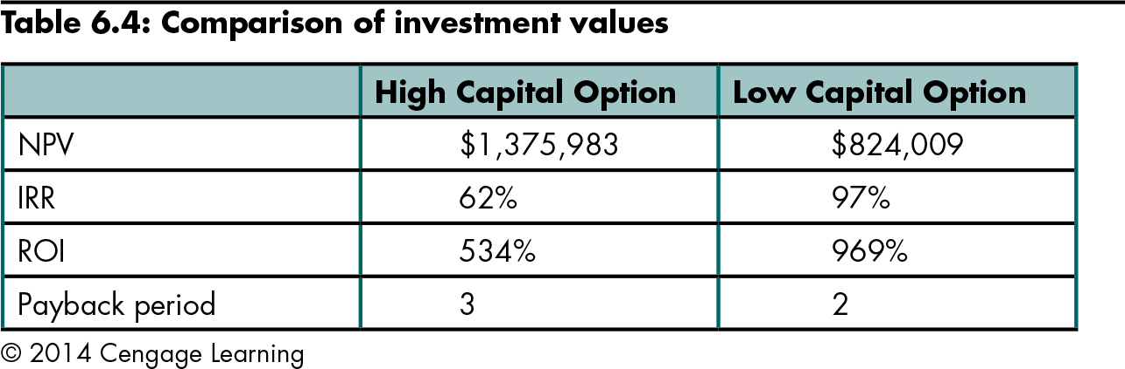
Evaluating the Results of the Analysis
Level 3 home

Slide 58
Level 3 Summary
Exploring the profitability of a financial venture by:
Calculating the NPV
Calculating the IRR
Determining the ROI
Determining the payback period

Slide 59
Chapter Summary
Calculating the values for simple financial transactions
Creating a projected cash flow estimate and amortization table
Evaluating the financial viability of alternative project options

